Slide 1
Studying climate change
Maths and the environment

Slide 2
How our teaching resources are designed for the classroom

Slide 3
I can understand how Earth’s polar ice caps are changing.

Slide 4
A forecast is a prediction of a future event occurring (based on data).
Extrapolation is the process of estimating unknown values that are outside the range of existing data.

Slide 5

Studying climate change
Comparing data between different periods of time
Using data about sea ice to make predictions

Slide 6
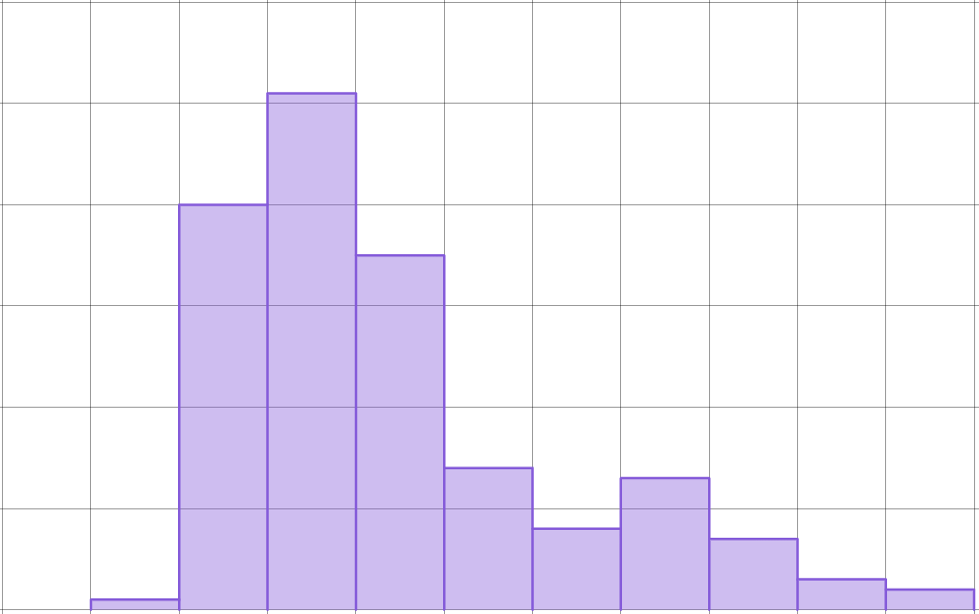
Comparing data between different periods of time
The graph shows data from the Met Office and HadCRUT5 about mean global temperatures each year from 1851 to 2024.
The horizontal axis shows whether it was warmer or colder than it was before industrialisation.
50
40
30
frequency
E.g. This bar represents years where the mean global temperature was between 0.8 and 1°C warmer than pre-industrial conditions.
20
10
0
-0.4
-0.2
0
0.2
0.4
0.6
0.8
1.0
1.2
1.4
1.6
annual global mean temperature expressed as a difference from pre-industrial conditions (°C)

Slide 7
Comparing data between different periods of time
The graph shows data from the Met Office and HadCRUT5 about mean global temperatures each year from 1851 to 2024.
The vertical axis shows the number of years represented by each bar.
50
40
30
E.g. There were 13 years where the mean global temperature was between 0.8 and 1°C warmer than pre-industrial conditions.
frequency
20
10
0
-0.4
-0.2
0
0.2
0.4
0.6
0.8
1.0
1.2
1.4
1.6
annual global mean temperature expressed as a difference from pre-industrial conditions (°C)

Slide 8
Comparing data between different periods of time
There are 174 years represented in this graph. But it is not clear from this graph whether the later years were warmer or colder than the earlier years.
We could compare different periods of time by splitting the data up into parts.
E.g. We could split the data into two equal time periods: 1851 to 1937 and 1938 to 2024.
50
40
30
frequency
20
10
0
-0.4
-0.2
0
0.2
0.4
0.6
0.8
1.0
1.2
1.4
1.6
annual global mean temperature expressed as a difference from pre-industrial conditions (°C)

Slide 9
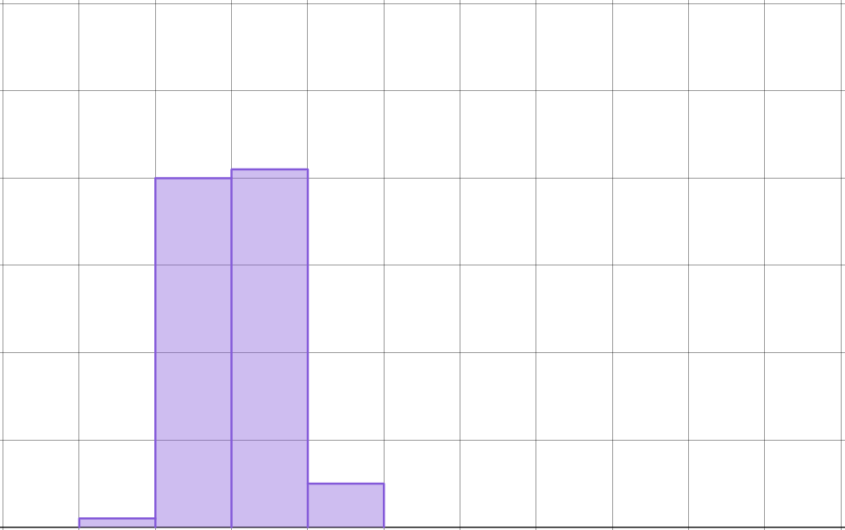
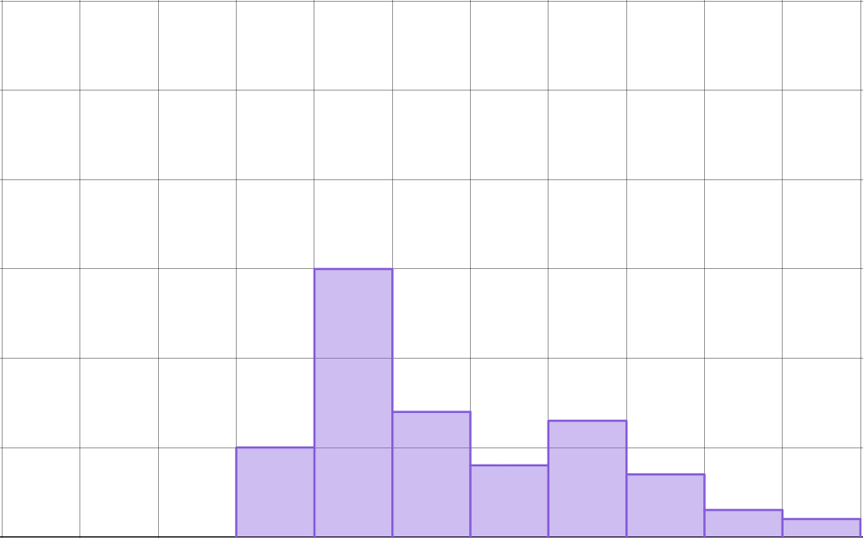
Comparing data between different periods of time
These graphs show the same data as the previous one, but each period of time is represented separately.
1851 to 1937
1938 to 2024
50
50
40
40
frequency
frequency
30
30
20
20
10
10
0
-0.4
-0.2
0
0.2
0.4
0.6
0.8
1.0
1.2
1.4
1.6
0
-0.4
-0.2
0
0.2
0.4
0.6
0.8
1.0
1.2
1.4
1.6
Both horizontal axes show annual global mean temperature expressed as a difference from pre-industrial conditions (°C).

Slide 10
Comparing data between different periods of time
By representing each period of time separately, we can make comparisons and draw conclusions.
1851 to 1937
1938 to 2024
50
50
40
40
frequency
frequency
30
30
20
20
10
10
0
-0.4
-0.2
0
0.2
0.4
0.6
0.8
1.0
1.2
1.4
1.6
0
-0.4
-0.2
0
0.2
0.4
0.6
0.8
1.0
1.2
1.4
1.6
Both horizontal axes show annual global mean temperature expressed as a difference from pre-industrial conditions (°C).

Slide 11
Comparing data between different periods of time
All of the annual global mean temperatures between 1851 and 1937 were between 0.4°C colder and 0.4°C warmer than pre-industrial conditions.
1851 to 1937
1938 to 2024
50
50
40
40
frequency
frequency
30
30
20
20
10
10
0
-0.4
-0.2
0
0.2
0.4
0.6
0.8
1.0
1.2
1.4
1.6
0
-0.4
-0.2
0
0.2
0.4
0.6
0.8
1.0
1.2
1.4
1.6
Both horizontal axes show annual global mean temperature expressed as a difference from pre-industrial conditions (°C).

Slide 12
Comparing data between different periods of time
All of the annual global mean temperatures between 1938 and 2024 were between 0 and 1.6°C warmer than pre-industrial conditions.
1851 to 1937
1938 to 2024
50
50
40
40
frequency
frequency
30
30
20
20
10
10
0
-0.4
-0.2
0
0.2
0.4
0.6
0.8
1.0
1.2
1.4
1.6
0
-0.4
-0.2
0
0.2
0.4
0.6
0.8
1.0
1.2
1.4
1.6
Both horizontal axes show annual global mean temperature expressed as a difference from pre-industrial conditions (°C).

Slide 13
Comparing data between different periods of time
We could also compare the modal class for each time period.
1851 to 1937
1938 to 2024
50
50
40
40
frequency
frequency
30
30
20
20
10
10
0
-0.4
-0.2
0
0.2
0.4
0.6
0.8
1.0
1.2
1.4
1.6
0
-0.4
-0.2
0
0.2
0.4
0.6
0.8
1.0
1.2
1.4
1.6
Both horizontal axes show annual global mean temperature expressed as a difference from pre-industrial conditions (°C).

Slide 14
Comparing data between different periods of time
The modal class for 1851 to 1937 is between 0 and 0.2°C.
The modal class for 1938 to 2024 is between 0.2 and 0.4°C.
1851 to 1937
1938 to 2024
50
50
40
40
frequency
frequency
30
30
20
20
10
10
0
-0.4
-0.2
0
0.2
0.4
0.6
0.8
1.0
1.2
1.4
1.6
0
-0.4
-0.2
0
0.2
0.4
0.6
0.8
1.0
1.2
1.4
1.6
Both horizontal axes show annual global mean temperature expressed as a difference from pre-industrial conditions (°C).

Slide 15
Comparing data between different periods of time
This data would suggest that annual mean global temperatures have been generally warmer since 1938 than they were before 1938.
1851 to 1937
1938 to 2024
50
50
40
40
frequency
frequency
30
30
20
20
10
10
0
-0.4
-0.2
0
0.2
0.4
0.6
0.8
1.0
1.2
1.4
1.6
0
-0.4
-0.2
0
0.2
0.4
0.6
0.8
1.0
1.2
1.4
1.6
Both horizontal axes show annual global mean temperature expressed as a difference from pre-industrial conditions (°C).

Slide 16
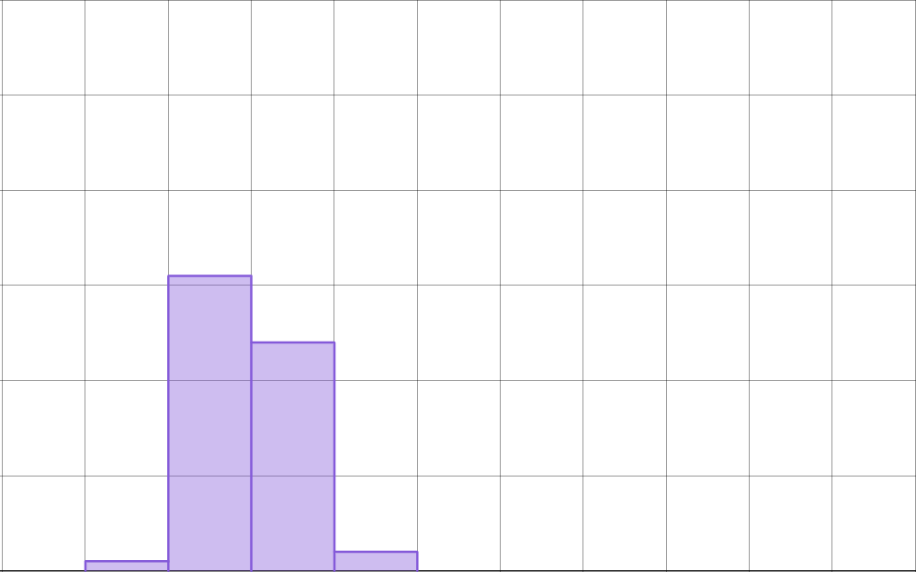
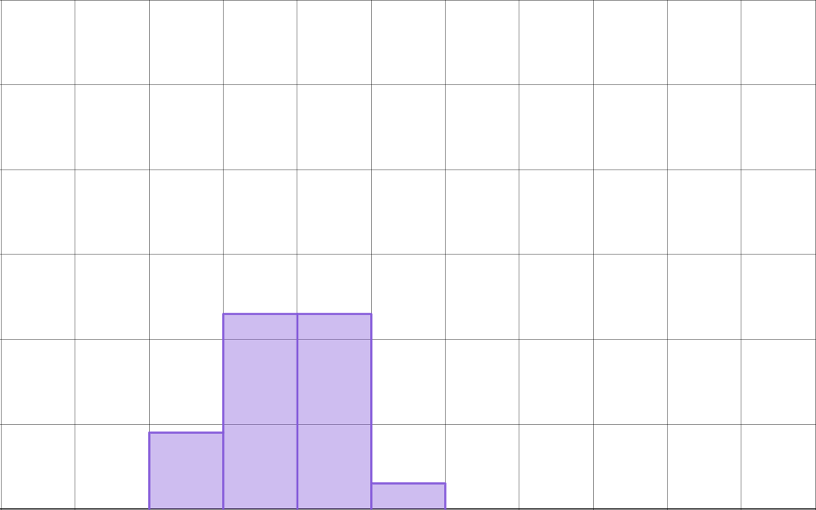
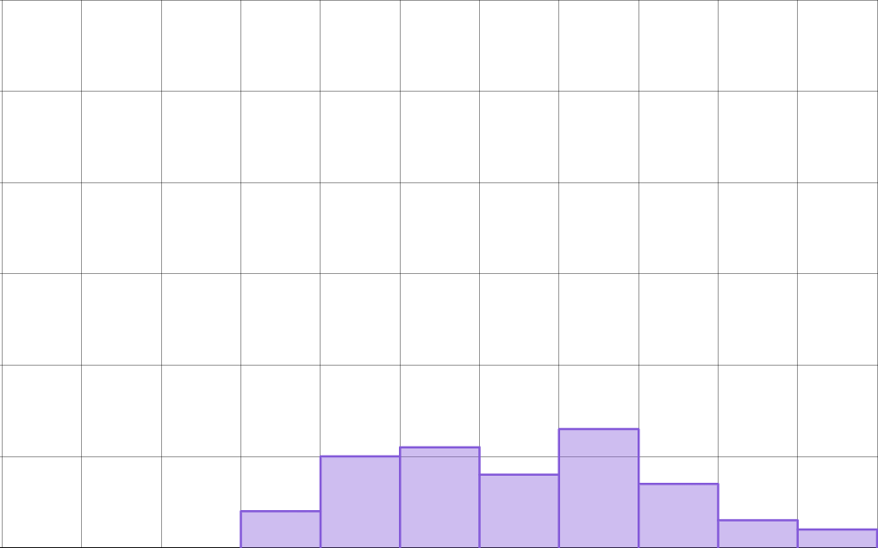
Comparing data between different periods of time
These graphs show the same data again, but split up into three equal periods of time. Similar comparisons could be made.
1851 to 1908
1909 to 1966
1967 to 2024
50
50
50
40
40
40
frequency
frequency
frequency
30
30
30
20
20
20
10
10
10
0
-0.4
0
0.4
0.8
1.2
1.6
0
-0.4
0
0.4
0.8
1.2
1.6
0
-0.4
0
0.4
0.8
1.2
1.6
Each horizontal axes show annual global mean temperature expressed as a difference from pre-industrial conditions (°C).

Slide 17
Comparing data between different periods of time
All data is between -0.4 and 0.4°C.
All data is between -0.3 and 0.5°C.
All data is between 0 and 1.6°C.
1851 to 1908
1909 to 1966
1967 to 2024
50
50
50
40
40
40
frequency
frequency
frequency
30
30
30
20
20
20
10
10
10
0
-0.4
0
0.4
0.8
1.2
1.6
0
-0.4
0
0.4
0.8
1.2
1.6
0
-0.4
0
0.4
0.8
1.2
1.6
Each horizontal axes show annual global mean temperature expressed as a difference from pre-industrial conditions (°C).

Slide 18
Comparing data between different periods of time
Modal class is between -0.2 and 0°C.
Modal classes are between 0 and 0.4°C.
Modal class is between 0.8 and 1°C.
1851 to 1908
1909 to 1966
1967 to 2024
50
50
50
40
40
40
frequency
frequency
frequency
30
30
30
20
20
20
10
10
10
0
-0.4
0
0.4
0.8
1.2
1.6
0
-0.4
0
0.4
0.8
1.2
1.6
0
-0.4
0
0.4
0.8
1.2
1.6
Each horizontal axes show annual global mean temperature expressed as a difference from pre-industrial conditions (°C).

Slide 19
Comparing data between different periods of time
This data would suggest that annual mean global temperatures have been generally increasing over time, since 1851.
1851 to 1908
1909 to 1966
1967 to 2024
50
50
50
40
40
40
frequency
frequency
frequency
30
30
30
20
20
20
10
10
10
0
-0.4
0
0.4
0.8
1.2
1.6
0
-0.4
0
0.4
0.8
1.2
1.6
0
-0.4
0
0.4
0.8
1.2
1.6
Each horizontal axes show annual global mean temperature expressed as a difference from pre-industrial conditions (°C).

Slide 20
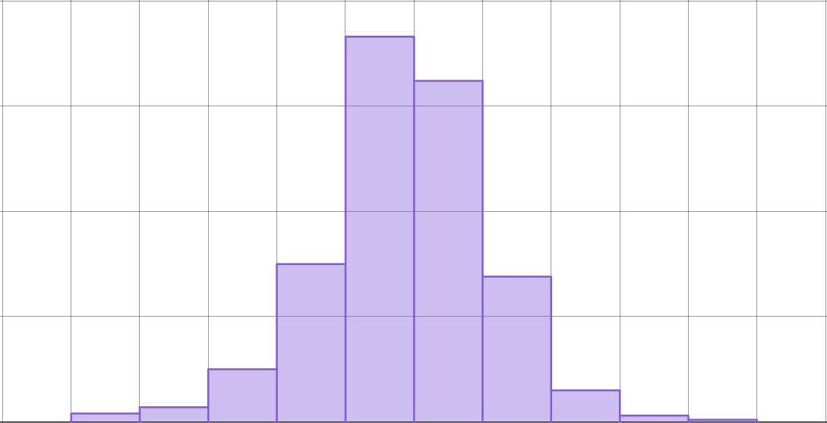
Comparing data between different periods of time
The graph shows data from the Met Office and OSI SAF about sea ice in the Antarctic for each month from 1979 to 2024.
Each value of the horizontal axis shows the difference between the actual area of sea ice for that month and the average area of sea ice for the same month across many years.
1979 to 2024
200
150
100
frequency
50
0
-3
-2.5
-2
-1.5
-1
-0.5
0
0.5
1
1.5
2
2.5
3
While this is a complex statistic, we can still interpret the overall data.
monthly Antarctic sea ice extent expressed as a difference from the 1981-2010 average for each month separately (million km²)

Slide 21

Comparing data between different periods of time
Which is the modal class?
1979 to 2024
-1 to -0.5 million km²
200
150
-0.5 to 0 million km²
100
frequency
50
0 to 0.5 million km²
0
-3
-2.5
-2
-1.5
-1
-0.5
0
0.5
1
1.5
2
2.5
3
monthly Antarctic sea ice extent expressed as a difference from the 1981-2010 average for each month separately (million km²)
0.5 to 1 million km²

Slide 22
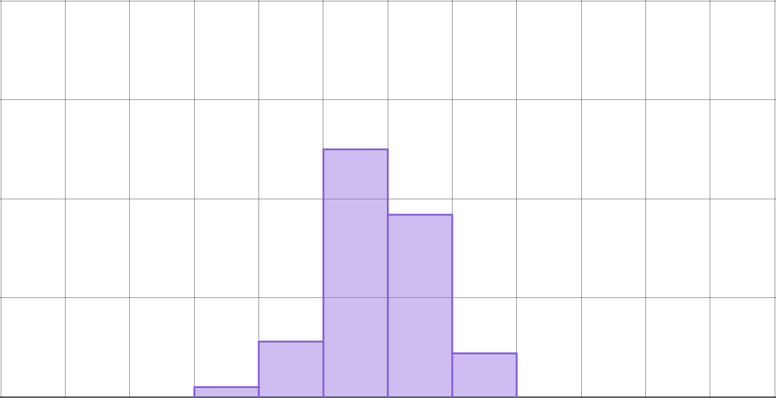
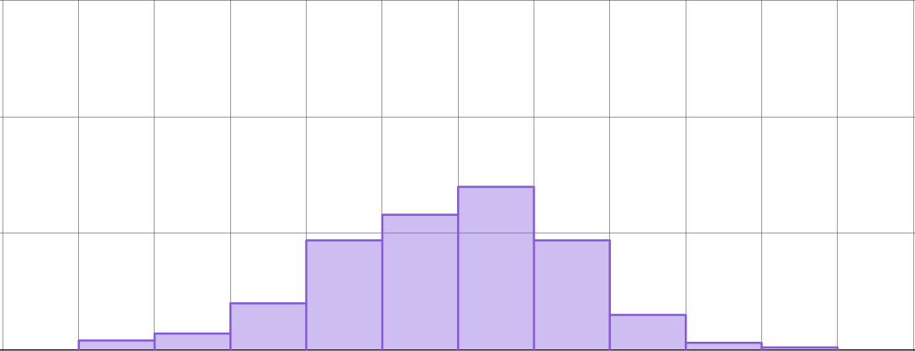
Comparing data between different periods of time
These graphs show the same data as the previous one, but split into two time periods.
For which period of time is the modal class greater?
2002 to 2024
1979 to 2001
150
100
frequency
50
0
-3
-2.5
-2
-1.5
-1
-0.5
0
0.5
1
1.5
2
2.5
3
2002 to 2024
150
100
frequency
50
0
-3
-2.5
-2
-1.5
-1
-0.5
0
0.5
1
1.5
2
2.5
3

Slide 23
Comparing data between different periods of time
True or false?
The extent of sea ice in the Antarctic was more consistent between 1979 and 2001 than it was between 2002 and 2024.
Explain your answer.
True E.g. The data appears less spread out in the top graph than the bottom graph.
1979 to 2001
150
100
frequency
50
0
-3
-2.5
-2
-1.5
-1
-0.5
0
0.5
1
1.5
2
2.5
3
2002 to 2024
150
100
frequency
50
0
-3
-2.5
-2
-1.5
-1
-0.5
0
0.5
1
1.5
2
2.5
3

Slide 24
Comparing data between different periods of time
True or false?
The extent of sea ice in the Antarctic was more consistent between 1979 and 2001 than it was between 2002 and 2024.
Explain your answer.
True E.g. All data for 1979 to 2001 is between -1.5 and 1
But for 2002 to 2024, the data is between -2.5 and 2
1979 to 2001
150
100
frequency
50
0
-3
-2.5
-2
-1.5
-1
-0.5
0
0.5
1
1.5
2
2.5
3
2002 to 2024
150
100
frequency
50
0
-3
-2.5
-2
-1.5
-1
-0.5
0
0.5
1
1.5
2
2.5
3

Slide 25
Comparing data between different periods of time
True or false?
The extent of sea ice in the Antarctic was more consistent between 1979 and 2001 than it was between 2002 and 2024.
Explain your answer.
True E.g. Most data for 1979 to 2001 is between -0.5 and 0.5
For 2002 to 2024, the data is more evenly spread.
1979 to 2001
150
100
frequency
50
0
-3
-2.5
-2
-1.5
-1
-0.5
0
0.5
1
1.5
2
2.5
3
2002 to 2024
150
100
frequency
50
0
-3
-2.5
-2
-1.5
-1
-0.5
0
0.5
1
1.5
2
2.5
3

Slide 26

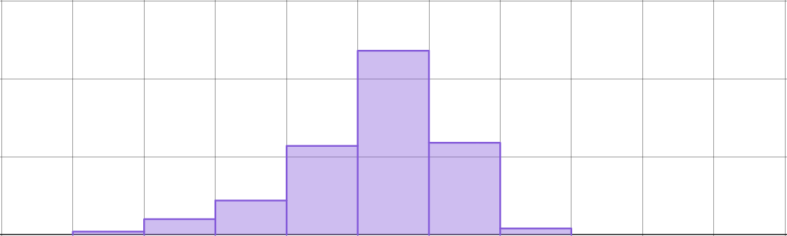
Comparing data between different periods of time
1) The graphs show data from the Met Office and OSI SAF about sea ice in the Arctic for each month from 1979 to 2024.
150
1979 to 2001
100
frequency
50
0
a) What was the modal class for 1979 to 2001?
-3
-2.5
-2
-1.5
-1
-0.5
0
0.5
1
1.5
2
150
2002 to 2024
100
b) What was the modal class for 2002 to 2024?
frequency
50
0
c) Did the extent of sea ice generally increase or decrease between the two periods of time? Explain your answer.
-3
-2.5
-2
-1.5
-1
-0.5
0
0.5
1
1.5
2
monthly Arctic sea ice extent expressed as a difference from the 1981-2010 average for each month separately (million km²)

Slide 27



Comparing data between different periods of time
30
1851 to 1908
2) The graphs show data from the Met Office and HadSST4 about sea-surface temperatures for each year from 1851 to 2024.
frequency
20
10
0
-1
-0.8
-0.6
-0.4
-0.2
0
0.2
0.4
0.6
0.8
1
30
1909 to 1966
frequency
Compare the sea-surface temperatures for the three periods of time. Describe any conclusions that you can draw from the data.
20
10
0
-1
-0.8
-0.6
-0.4
-0.2
0
0.2
0.4
0.6
0.8
1
30
1967 to 2024
frequency
20
10
0
-1
-0.8
-0.6
-0.4
-0.2
0
0.2
0.4
0.6
0.8
1
annual global mean sea-surface temperature expressed as a difference from 1981-2010 average (°C)

Slide 28
Comparing data between different periods of time
1) The graphs show data from the Met Office and OSI SAF about sea ice in the Arctic for each month from 1979 to 2024.
150
1979 to 2001
100
frequency
50
0
a) What was the modal class for 1979 to 2001?
-3
-2.5
-2
-1.5
-1
-0.5
0
0.5
1
1.5
2
150
2002 to 2024
0 to 0.5 million km²
100
frequency
50
b) What was the modal class for 2002 to 2024?
0
-3
-2.5
-2
-1.5
-1
-0.5
0
0.5
1
1.5
2
monthly Arctic sea ice extent expressed as a difference from the 1981-2010 average for each month separately (million km²)
-1 to -0.5 million km²

Slide 29
Comparing data between different periods of time
c) Did the extent of sea ice generally increase or decrease between the two periods of time? Explain your answer.
150
1979 to 2001
100
frequency
50
0
The extent of sea ice is generally less for 2002 to 2024 than for 1979 to 2001, so it generally decreased.
-3
-2.5
-2
-1.5
-1
-0.5
0
0.5
1
1.5
2
150
2002 to 2024
100
frequency
50
E.g. explanation:
The modal class is lower for 2002-2024 than for 1979-2001.
0
-3
-2.5
-2
-1.5
-1
-0.5
0
0.5
1
1.5
2
monthly Arctic sea ice extent expressed as a difference from the 1981-2010 average for each month separately (million km²)

Slide 30
Comparing data between different periods of time
c) Did the extent of sea ice generally increase or decrease between the two periods of time? Explain your answer.
150
1979 to 2001
100
frequency
50
0
The extent of sea ice is generally less for 2002 to 2024 than for 1979 to 2001, so it generally decreased.
-3
-2.5
-2
-1.5
-1
-0.5
0
0.5
1
1.5
2
150
2002 to 2024
100
frequency
50
E.g. explanation:
The data for 1979 to 2001 is between -1 and 1.5, while the data for 2002 to 2024 is between -2.5 and 0.5
0
-3
-2.5
-2
-1.5
-1
-0.5
0
0.5
1
1.5
2
monthly Arctic sea ice extent expressed as a difference from the 1981-2010 average for each month separately (million km²)

Slide 31
Comparing data between different periods of time
30
1851 to 1908
2) The graphs show data from the Met Office and HadSST4 about sea-surface temperatures for each year from 1851 to 2024.
frequency
20
10
0
-1
-0.8
-0.6
-0.4
-0.2
0
0.2
0.4
0.6
0.8
1
30
1909 to 1966
frequency
Compare the sea-surface temperatures for the three periods of time. Describe any conclusions that you can draw from the data.
20
10
0
-1
-0.8
-0.6
-0.4
-0.2
0
0.2
0.4
0.6
0.8
1
30
1967 to 2024
frequency
20
10
0
-1
-0.8
-0.6
-0.4
-0.2
0
0.2
0.4
0.6
0.8
1
annual global mean sea-surface temperature expressed as a difference from 1981-2010 average (°C)

Slide 32
Comparing data between different periods of time
150
1851 to 1908
Example:
frequency
100
50
The annual global mean sea-surface temperatures appeared to increase slightly between the first two time periods.
0
-1
-0.8
-0.6
-0.4
-0.2
0
0.2
0.4
0.6
0.8
1
150
1909 to 1966
frequency
100
50
0
-1
-0.8
-0.6
-0.4
-0.2
0
0.2
0.4
0.6
0.8
1
The modal class for each period of time is the same (-0.6 to -0.4). However the data for 1851 to 1908 is between -1 and -0.2, where as it is between -1 and 0 from 1909 to 1966.
150
1967 to 2024
frequency
100
50
0
-1
-0.8
-0.6
-0.4
-0.2
0
0.2
0.4
0.6
0.8
1
annual global mean sea-surface temperature expressed as a difference from 1981-2010 average (°C)

Slide 33
Comparing data between different periods of time
150
1851 to 1908
Example:
frequency
100
50
For the majority of years from 1967 to 2024, the annual global sea-surface temperatures were higher than they were between 1851 and 1966.
0
-1
-0.8
-0.6
-0.4
-0.2
0
0.2
0.4
0.6
0.8
1
150
1909 to 1966
frequency
100
50
0
-1
-0.8
-0.6
-0.4
-0.2
0
0.2
0.4
0.6
0.8
1
The modal classes from 1967 to 2024 are between -0.2 and 0.2
Also the data from 1967 to 2024 is between -0.6 and 0.8
150
1967 to 2024
frequency
100
50
0
-1
-0.8
-0.6
-0.4
-0.2
0
0.2
0.4
0.6
0.8
1
annual global mean sea-surface temperature expressed as a difference from 1981-2010 average (°C)

Slide 34
Comparing data between different periods of time
150
1851 to 1908
More precise methods can also be used to compare the datasets (e.g. mean or median) if pupils already know how to use them.
frequency
100
50
0
-1
-0.8
-0.6
-0.4
-0.2
0
0.2
0.4
0.6
0.8
1
150
1909 to 1966
frequency
100
50
0
-1
-0.8
-0.6
-0.4
-0.2
0
0.2
0.4
0.6
0.8
1
150
1967 to 2024
frequency
100
50
0
-1
-0.8
-0.6
-0.4
-0.2
0
0.2
0.4
0.6
0.8
1
annual global mean sea-surface temperature expressed as a difference from 1981-2010 average (°C)

Slide 35
Studying climate change
Comparing data between different periods of time
Using data about sea ice to make predictions

Slide 36
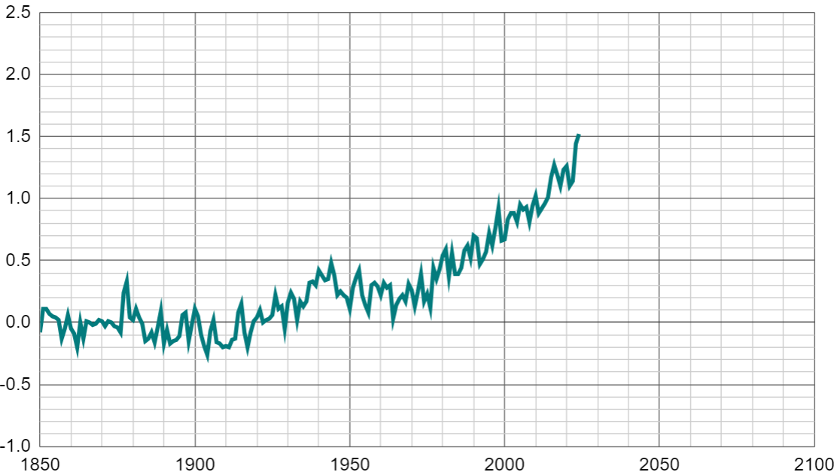
Using data about sea ice to make predictions
The graph shows data from the Met Office and HadCRUT5 about mean global temperatures each year from 1850 to 2024.
2.5
Each temperature shows whether it was warmer or colder than it was before industrialisation.
2.0
1.5
annual global mean temperature expressed as a difference from pre-industrial conditions (°C)
1.0
E.g. This point represents the year 2020, where the mean global temperature was 1.3°C warmer than during pre-industrial conditions.
0.5
0.0
-0.5
-1.0
1850
1900
1950
2000
year

Slide 37


Using data about sea ice to make predictions
The graph shows data from the Met Office and HadCRUT5 about mean global temperatures each year from 1850 to 2024.
2.5
What do you notice about this data?
2.0
1.5
The mean global temperatures go up and down each year.
annual global mean temperature expressed as a difference from pre-industrial conditions (°C)
1.0
0.5
0.0
-0.5
-1.0
1850
1900
1950
2000
Sofia
year

Slide 38

Using data about sea ice to make predictions
The graph shows data from the Met Office and HadCRUT5 about mean global temperatures each year from 1850 to 2024.
2.5
2.0
For most years between 1850 and 1940, the mean global temperatures stayed within a similar set of values.
1.5
annual global mean temperature expressed as a difference from pre-industrial conditions (°C)
1.0
0.5
0.0
-0.5
-1.0
1850
1900
1950
2000
Jun
year

Slide 39

Using data about sea ice to make predictions
The graph shows data from the Met Office and HadCRUT5 about mean global temperatures each year from 1850 to 2024.
2.5
The mean global temperatures also stayed between a similar set of values from 1940 to 1970.
But these are higher than they were from 1850 to 1940.
2.0
1.5
annual global mean temperature expressed as a difference from pre-industrial conditions (°C)
1.0
0.5
0.0
-0.5
-1.0
1850
1900
1950
2000
year
Aisha

Slide 40

Using data about sea ice to make predictions
The graph shows data from the Met Office and HadCRUT5 about mean global temperatures each year from 1850 to 2024.
2.5
2.0
I can see upward trend in the mean global temperatures from around 1970 onwards.
1.5
annual global mean temperature expressed as a difference from pre-industrial conditions (°C)
1.0
0.5
0.0
-0.5
-1.0
1850
1900
1950
2000
year
Sam

Slide 41
Using data about sea ice to make predictions
The graph shows data from the Met Office and HadCRUT5 about mean global temperatures each year from 1850 to 2024.
2.5
2.0
It still goes up and down. But from 1970 onwards, it generally seems to go up more than it goes down.
1.5
annual global mean temperature expressed as a difference from pre-industrial conditions (°C)
1.0
0.5
0.0
-0.5
-1.0
1850
1900
1950
2000
year
Sam

Slide 42

Using data about sea ice to make predictions
The graph shows data from the Met Office and HadCRUT5 about mean global temperatures each year from 1850 to 2024.
2.5
Mean global temperatures have been higher than they were during pre-industrial conditions for nearly every year after 1935.
2.0
1.5
annual global mean temperature expressed as a difference from pre-industrial conditions (°C)
1.0
0.5
0.0
-0.5
-1.0
1850
1900
1950
2000
year
Izzy

Slide 43
Using data about sea ice to make predictions
Trends in data can be used to make predictions about future data.
2.5
2.0
1.5
annual global mean temperature expressed as a difference from pre-industrial conditions (°C)
1.0
0.5
0.0
-0.5
-1.0
1850
1900
1950
2000
2050
year

Slide 44
Using data about sea ice to make predictions
If mean global temperatures continue to increase in the way they have since 1970, what range of data could we expect to record in 2050?
2.5
2.0
We could expect mean global temperatures to be between 1.6 and 2°C higher than they were during pre-industrial conditions.
1.5
annual global mean temperature expressed as a difference from pre-industrial conditions (°C)
1.0
0.5
0.0
-0.5
-1.0
1850
1900
1950
2000
2050
year

Slide 45
Using data about sea ice to make predictions
If mean global temperatures continue to increase in the way they have since 1970, what range of data could we expect to record in 2070?
2.5
We could expect mean global temperatures to be between 2 and 2.45°C higher than they were during pre-industrial conditions.
2.0
1.5
annual global mean temperature expressed as a difference from pre-industrial conditions (°C)
1.0
0.5
0.0
-0.5
How confident can we be about these predictions?
-1.0
1850
1900
1950
2000
2050
2100
year

Slide 46
Using data about sea ice to make predictions
Trends in data can be affected by events or actions. So, the further we predict into the future, the less confident we may be about the prediction.
2.5
2.0
1.5
annual global mean temperature expressed as a difference from pre-industrial conditions (°C)
1.0
0.5
0.0
-0.5
-1.0
1850
1900
1950
2000
2050
2100
year

Slide 47
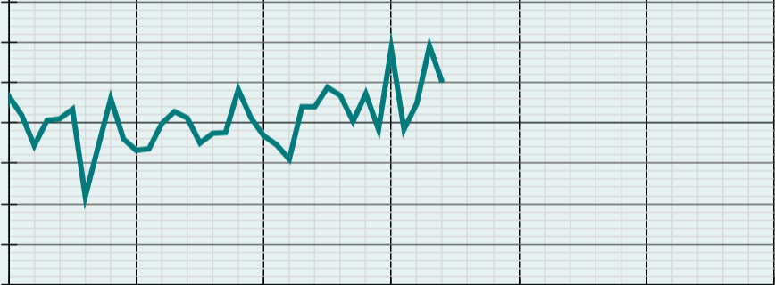
Using data about sea ice to make predictions
The graphs show data from the Met Office and OSI SAF about sea ice in the Antarctic for each November from 1980 to 2014.
1.5
1.0
Antarctic sea ice extent for November expressed as a difference from the 1981-2010 average for each November (million km²)
0.5
0.0
-0.5
-1.0
-1.5
1980
1990
2000
2010
2020
year

Slide 48
Using data about sea ice to make predictions
True or false? The extent of sea ice increases and decreases from one year to the next.
True
1.5
Explain your answer.
1.0
Antarctic sea ice extent for November expressed as a difference from the 1981-2010 average for each November (million km²)
The values differ each year. Sometimes there is an increase; sometimes there is a decrease.
0.5
0.0
-0.5
-1.0
-1.5
1980
1990
2000
2010
2020
year

Slide 49
Using data about sea ice to make predictions
True or false? Despite changes between years, the extent of sea ice remained within a similar range of values for most years between 1980 and 2010.
True
1.5
Explain your answer.
1.0
Antarctic sea ice extent for November expressed as a difference from the 1981-2010 average for each November (million km²)
Apart from 1986 and 2010, all values are between -0.5 and +0.5.
0.5
0.0
-0.5
-1.0
-1.5
1980
1990
2000
2010
2020
year

Slide 50

Using data about sea ice to make predictions
Jacob notices a slight upward trend in the data. He draws a pair of lines to predict what data we might expect to observe in 2030.
Based on his lines, we could expect to observe values between and .
0.3
1.2
1.5
1.0
Antarctic sea ice extent for November expressed as a difference from the 1981-2010 average for each November (million km²)
0.5
0.0
-0.5
-1.0
-1.5
1980
1990
2000
2010
2020
2030
2040
year

Slide 51
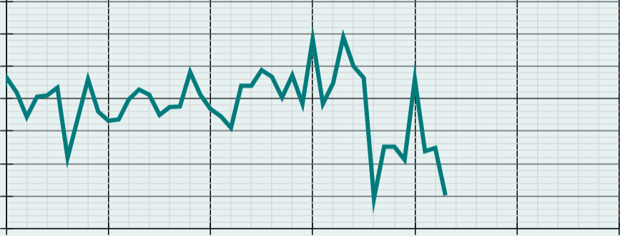
Using data about sea ice to make predictions
Jacob predicts that the extent of Antarctic sea ice in 2030 will be 0.3 to 1.2 million km² greater than the 1981-2010 average for each November.
Explain why this prediction may not come true.
The trend may change. E.g. the graph now includes data from 2015 to 2024.
1.5
1.0
Antarctic sea ice extent for November expressed as a difference from the 1981-2010 average for each November (million km²)
0.5
0.0
-0.5
-1.0
-1.5
1980
1990
2000
2010
2020
2030
2040
year

Slide 52
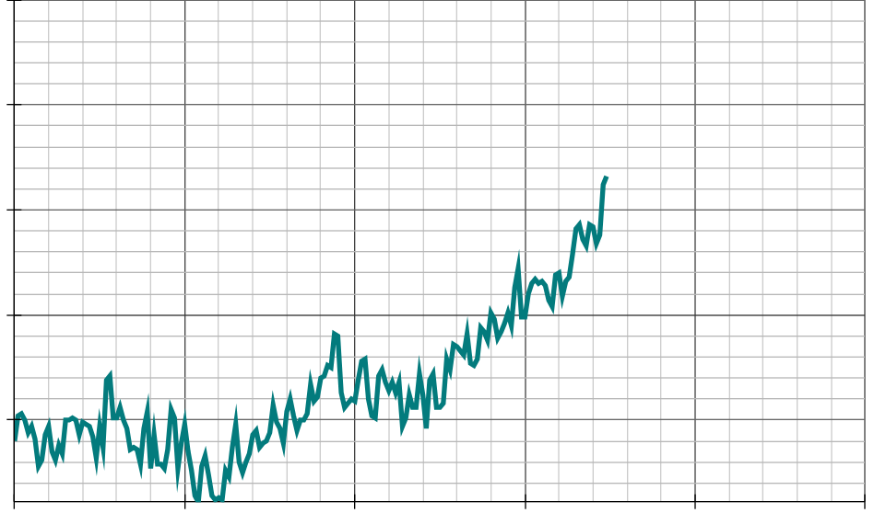
Using data about sea ice to make predictions
1) The graph shows data from the Met Office and HadSST4 about sea-surface temperatures for each year from 1851 to 2024.
1.5
a) Write down at least two observations that you make about any trends in the data.
1.0
0.5
annual global mean sea-surface temperature expressed as a difference from 1981-2010 average (°C)
0.0
-0.5
1850
1900
1950
2000
2050
2100
year

Slide 53
Using data about sea ice to make predictions
1) The graph shows data from the Met Office and HadSST4 about sea-surface temperatures for each year from 1851 to 2024.
1.5
b) If the trend in mean global sea-surface temperatures continues in the way it has since 1970, what range of data could we expect to observe in:
i) 2040?
ii) 2050?
iii) 2060?
1.0
0.5
annual global mean sea-surface temperature expressed as a difference from 1981-2010 average (°C)
0.0
-0.5
1850
1900
1950
2000
2050
2100
year

Slide 54
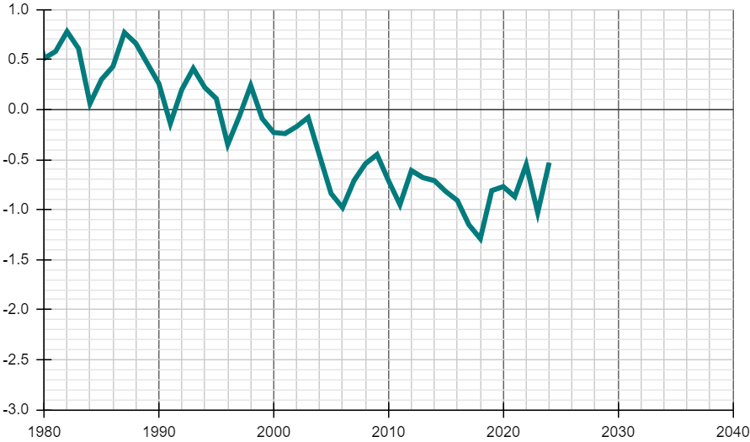
Using data about sea ice to make predictions
2) The graph shows data from the Met Office and OSI SAF about sea ice in the Arctic for each January from 1980 to 2024.
1.0
a) Write down at least one observation that you make about any trends in the data.
0.5
0.0
-0.5
Arctic sea ice extent for January expressed as a difference from the 1981-2010 average for each January (million km²)
-1.5
-2.0
-2.5
-3.0
1980
1990
2000
2010
2020
2030
2040
year

Slide 55
Using data about sea ice to make predictions
2) The graph shows data from the Met Office and OSI SAF about sea ice in the Arctic for each January from 1980 to 2024.
1.0
b) If the trend in the extent of Arctic sea ice continues in the way it has since 1980, what range of data could we expect to see in:
i) 2030?
ii) 2035?
iii) 2040?
0.5
0.0
-0.5
Arctic sea ice extent for January expressed as a difference from the 1981-2010 average for each January (million km²)
-1.5
-2.0
-2.5
-3.0
1980
1990
2000
2010
2020
2030
2040
year

Slide 56
Using data about sea ice to make predictions
1) The graph shows data from the Met Office and HadSST4 about sea-surface temperatures for each year from 1851 to 2024.
1.5
a) Write down at least two observations that you make about any trends in the data.
1.0
0.5
Examples:
The global mean sea-surface temperatures remain relatively stable between 1850 and 1930.
annual global mean sea-surface temperature expressed as a difference from 1981-2010 average (°C)
0.0
-0.5
1850
1900
1950
2000
2050
2100
year

Slide 57
Using data about sea ice to make predictions
1) The graph shows data from the Met Office and HadSST4 about sea-surface temperatures for each year from 1851 to 2024.
1.5
a) Write down at least two observations that you make about any trends in the data.
1.0
0.5
Examples:
There is an upward trend from 1920 to 1945.
annual global mean sea-surface temperature expressed as a difference from 1981-2010 average (°C)
0.0
-0.5
1850
1900
1950
2000
2050
2100
year

Slide 58
Using data about sea ice to make predictions
1) The graph shows data from the Met Office and HadSST4 about sea-surface temperatures for each year from 1851 to 2024.
1.5
a) Write down at least two observations that you make about any trends in the data.
1.0
0.5
Examples:
The global mean sea-surface temperatures remain relatively stable between 1945 and 1980.
annual global mean sea-surface temperature expressed as a difference from 1981-2010 average (°C)
0.0
-0.5
1850
1900
1950
2000
2050
2100
year

Slide 59
Using data about sea ice to make predictions
1) The graph shows data from the Met Office and HadSST4 about sea-surface temperatures for each year from 1851 to 2024.
1.5
a) Write down at least two observations that you make about any trends in the data.
1.0
0.5
Examples:
There is a clear upward trend from 1980 onwards.
annual global mean sea-surface temperature expressed as a difference from 1981-2010 average (°C)
0.0
-0.5
1850
1900
1950
2000
2050
2100
year

Slide 60
Using data about sea ice to make predictions
1.5
b) If the trend in mean global sea-surface temperatures continues in the way it has since 1970, what range of data could we expect to observe in:
i) 2040?
ii) 2050?
iii) 2060?
1.0
0.5
annual global mean sea-surface temperature expressed as a difference from 1981-2010 average (°C)
0.0
0.5 to 0.8°C
-0.5
0.65 to 0.95°C
0.8 to 1.1°C
1850
1900
1950
2000
2050
2100
year
Pupils’ answers may differ slightly from the values given.

Slide 61
Using data about sea ice to make predictions
2) The graph shows data from the Met Office and OSI SAF about sea ice in the Arctic for each January from 1980 to 2024.
1.0
a) Write down at least one observation that you make about any trends in the data.
0.5
0.0
-0.5
Arctic sea ice extent for January expressed as a difference from the 1981-2010 average for each January (million km²)
Examples:
Overall, there is a downward trend from 1980 onwards.
-1.5
-2.0
-2.5
-3.0
1980
1990
2000
2010
2020
2030
2040
year

Slide 62
Using data about sea ice to make predictions
2) The graph shows data from the Met Office and OSI SAF about sea ice in the Arctic for each January from 1980 to 2024.
1.0
a) Write down at least one observation that you make about any trends in the data.
0.5
0.0
-0.5
Arctic sea ice extent for January expressed as a difference from the 1981-2010 average for each January (million km²)
Examples:
The trend possibly changes from around 2006 to something slightly more stable.
-1.5
-2.0
-2.5
-3.0
1980
1990
2000
2010
2020
2030
2040
year

Slide 63
Using data about sea ice to make predictions
1.0
b) If the trend in the extent of Arctic sea ice continues in the way it has since 1980, what range of data could we expect to in:
i) 2030?
ii) 2035?
iii) 2040?
0.5
0.0
-0.5
Arctic sea ice extent for January expressed as a difference from the 1981-2010 average for each January (million km²)
-1.5
-2.5 to -1.6 km²
-2.0
-2.5
-2.7 to -1.8 km²
-3.0
-2.9 to -2.0 km²
1980
1990
2000
2010
2020
2030
2040
year
Pupils’ answers may differ slightly from the values given.

Slide 64
Studying climate change
The effects of climate change can be observed through data.
A dataset can be represented in multiple different ways.
Comparisons can be made between different periods of time and trends can be interpreted.
By analysing how the northern or southern polar ice caps have changed, predictions can be made.

Slide 65

© Oak National Academy 2024.
Produced in partnership with Mathematics in Education and Industry.
Licensed on the Open Government Licence v3.0, except where otherwise stated. See Oak terms and conditions.

